Slide 1
Overview of the Course

Slide 2
Overview of the Course
Recap of MLP and
RNN / LSTM / GRU

Slide 3
Overview of the Course
Recap of MLP and
RNN / LSTM / GRU
Recap of NLP Basics

Slide 4
Overview of the Course
Recap of MLP and
RNN / LSTM / GRU
Neural Language Modeling
Recap of NLP Basics

Slide 5
Overview of the Course
Recap of MLP and
RNN / LSTM / GRU
Neural Language Modeling
Recap of NLP Basics
Text Autocomplete System

Slide 6
Overview of the Course
Recap of MLP and
RNN / LSTM / GRU
Neural Language Modeling
Sequence to Sequence Modeling
Recap of NLP Basics
Text Autocomplete System

Slide 7
Overview of the Course
Recap of MLP and
RNN / LSTM / GRU
Neural Language Modeling
Sequence to Sequence Modeling
Recap of NLP Basics
Text Autocomplete System
Neural Machine Translation

Slide 8
Overview of the Course
Recap of MLP and
RNN / LSTM / GRU
Neural Language Modeling
Sequence to Sequence Modeling
Recap of NLP Basics
Text Autocomplete System
Neural Machine Translation
Transformer Model

Slide 9
Overview of the Course
Recap of MLP and
RNN / LSTM / GRU
Neural Language Modeling
Sequence to Sequence Modeling
Recap of NLP Basics
Text Autocomplete System
Neural Machine Translation
Fine-Tuning BERT
Transformer Model

Slide 10
Overview of the Course
Recap of MLP and
RNN / LSTM / GRU
Neural Language Modeling
Sequence to Sequence Modeling
Recap of NLP Basics
Text Autocomplete System
Neural Machine Translation
Fine-Tuning BERT
Keyword Identiﬁcation in speech
Transformer Model

Slide 11
Overview of the Course
Recap of MLP and
RNN / LSTM / GRU
Neural Language Modeling
Sequence to Sequence Modeling
Recap of NLP Basics
Text Autocomplete System
Neural Machine Translation
Fine-Tuning BERT
Keyword Identiﬁcation in speech
Chatbot using RASA
Transformer Model

Slide 12

Projects in the Course
Building an Auto-completion System

Slide 13

Projects in the Course
Building an Auto-completion System
Translating Text from Russian to English

Slide 14

Projects in the Course
Fine-Tuning BERT for Sentiment Analysis

Slide 15
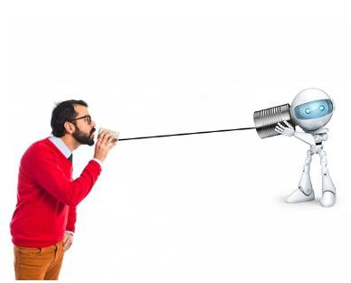
Projects in the Course
Fine-Tuning BERT for Sentiment Analysis
Keyword Identiﬁcation in Speech

Slide 16

Projects in the Course
Fine-Tuning BERT for Sentiment Analysis
Keyword Identiﬁcation in Speech
Build a Chatbot using RASA

Slide 17
Thank You

